Slide 1
Linear Algebra
Chapter 2
Dot Product

Slide 2
Agenda
Dot Product
Length of a vector
Unit vector
Norm

Slide 3
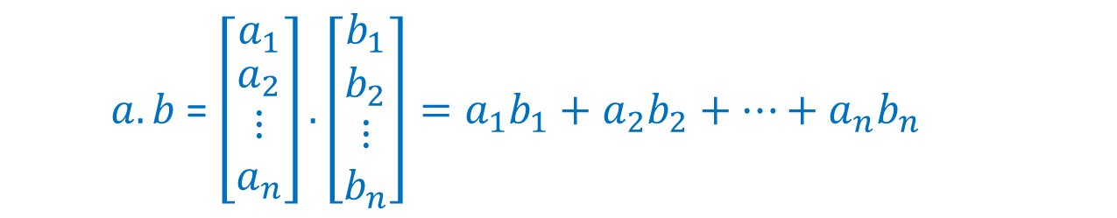

Dot Product
Definition: The dot product or inner product of two vectors $a,b$ in $ℝ^{n}$ is
$a.b$ = $\left[\begin{matrix}a_{1} \\ \begin{aligned}a_{2} \\ ⋮ \\ a_{n}\end{aligned}\end{matrix}\right].\left[\begin{matrix}b_{1} \\ \begin{aligned}b_{2} \\ ⋮ \\ b_{n}\end{aligned}\end{matrix}\right]=a_{1}b_{1}+a_{2}b_{2}+…+a_{n}b_{n}$
Thinking of $a, b$as column vectors, this is same as $a^{T}b$
Note: The dot product of two vectors is a scalar

Slide 4
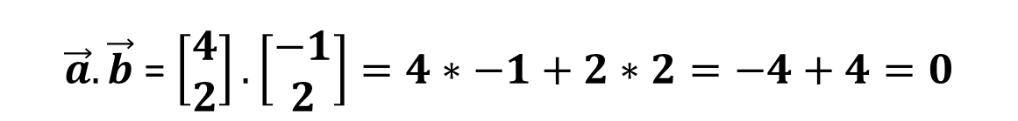

Dot Product
Example: Let $\vec{a}=\left[\begin{aligned}4 \\ 2\end{aligned}\right],\vec{b}=\left[\begin{aligned}−1 \\ 2\end{aligned}\right]$. Find $\vec{a}.\vec{b}$?
$\vec{a}.\vec{b}$ = $\left[\begin{aligned}4 \\ 2\end{aligned}\right]. \left[\begin{aligned}−1 \\ 2\end{aligned}\right]=4∗−1+2∗2=−4+4=0$
Dot product is zero. The above two vectors are perpendicular.
The angle between them is $90^{°}$.

Slide 5
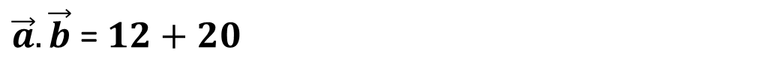
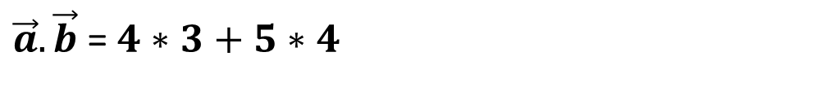
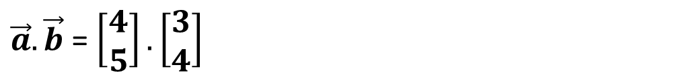
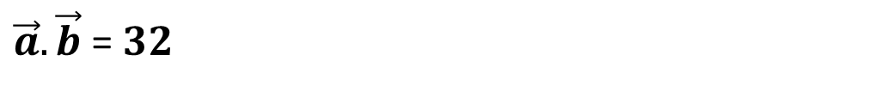
Dot Product
Example: Let $\vec{a}=\left[\begin{aligned}4 \\ 5\end{aligned}\right],\vec{b}=\left[\begin{aligned}3 \\ 4\end{aligned}\right]$. Find $\vec{a}.\vec{b}$?
$\vec{a}.\vec{b}$ = $\left[\begin{aligned}4 \\ 5\end{aligned}\right]. \left[\begin{aligned}3 \\ 4\end{aligned}\right]$
$\vec{a}.\vec{b}$ = $4∗3+5∗4$
$\vec{a}.\vec{b}$ = $12+20$
$\vec{a}.\vec{b}$ = $32$

Slide 6
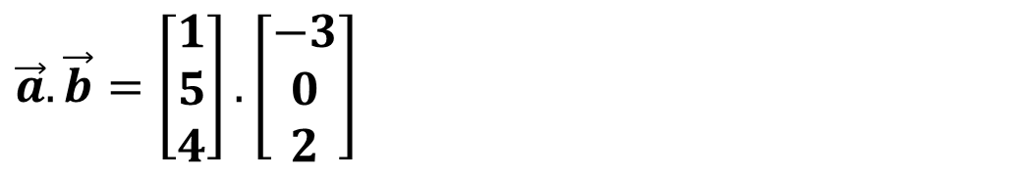

Dot Product
Example: Let $\vec{a}=\left[\begin{aligned}1 \\ 5 \\ 4\end{aligned}\right],\vec{b}=\left[\begin{aligned}−3 \\ 0 \\ 2\end{aligned}\right]$. Find $\vec{a}.\vec{b}$?
$$\vec{a}.\vec{b}=\left[\begin{aligned}1 \\ 5 \\ 4\end{aligned}\right].\left[\begin{aligned}−3 \\ 0 \\ 2\end{aligned}\right]$$
$$\vec{a}.\vec{b}=1∗−3+5∗0+4∗2$$
$$\vec{a}.\vec{b}=−3+0+8$$
$$\vec{a}.\vec{b}=5$$

Slide 7

Dot Product
Properties of the Dot product: Let $x,y,z$ be vectors in $ℝ^{n}$ and let $c$ be a scalar.
Commutative: $x.y=y.x$
Distributive: $\left(x+y\right).z=x.z+y.z$
Associative: $\left(cx\right).y=c(x.y)$

Slide 8
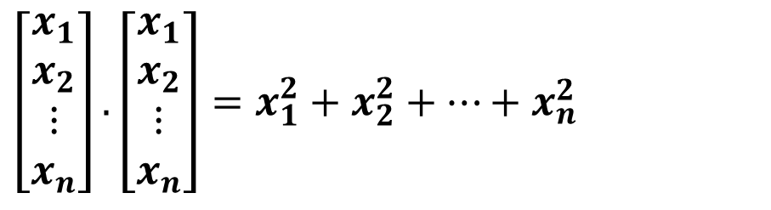
Dot Product
The dot product of a vector with itself is an important special case:
$$\left[\begin{aligned}x_{1} \\ x_{2} \\ ⋮ \\ x_{n}\end{aligned}\right].\left[\begin{aligned}x_{1} \\ x_{2} \\ ⋮ \\ x_{n}\end{aligned}\right]=x_{1}^{2}+x_{2}^{2}+…+x_{n}^{2}$$
Therefore, for any vector $x$, we have:
$x.x≥0$
$x.x=0⇔x=0$

Slide 9
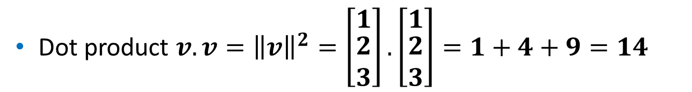

Dot Product
Example: Let $v=\left[\begin{matrix}1 \\ \begin{aligned}2 \\ 3\end{aligned}\end{matrix}\right]$.
The dot product with itself is $v.v={\left\|v\right\|}^{2}=14$.
Dot product $v.v={\left\|v\right\|}^{2}=\left[\begin{matrix}1 \\ \begin{aligned}2 \\ 3\end{aligned}\end{matrix}\right].\left[\begin{matrix}1 \\ \begin{aligned}2 \\ 3\end{aligned}\end{matrix}\right]=1+4+9=14$
Instead of a $90^{°}$ angle between vectors we have $0^{°}$.
The answer is not zero because $v$ is not perpendicular to itself.

Slide 10

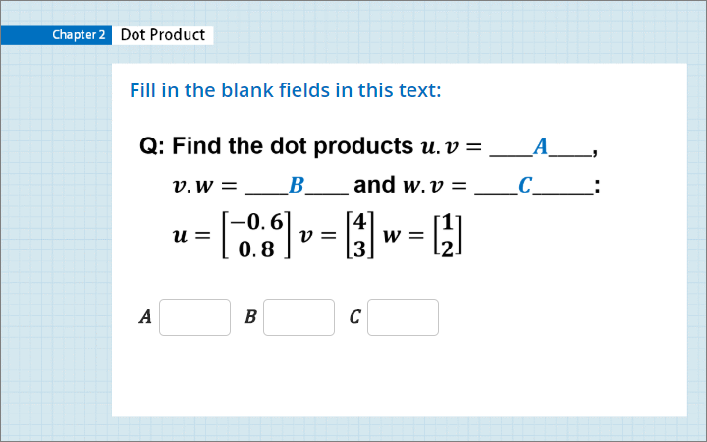
Quiz
Click the Quiz button to edit this object

Slide 11

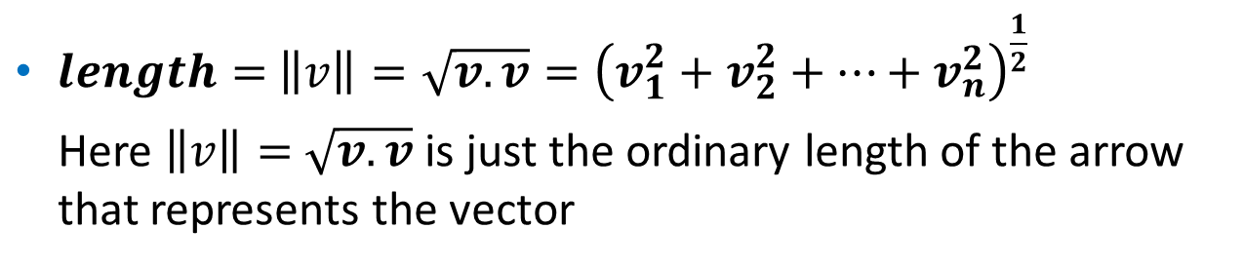
Length
The dot product $v.v$ gives the length of $v$ squared.
Definition: The length $\left\|v\right\|$ of the vector $v$ is the square root of $v.v:$
$length=$ $\left\|v\right\|=\sqrt{v.v}={\left(v_{1}^{2}+v_{2}^{2}+…+v_{n}^{2}\right)}^{\frac{1}{2}}$
Here $\left\|v\right\|=$ $\sqrt{v.v}$ is just the ordinary length of the arrow that represents the vector

Slide 12
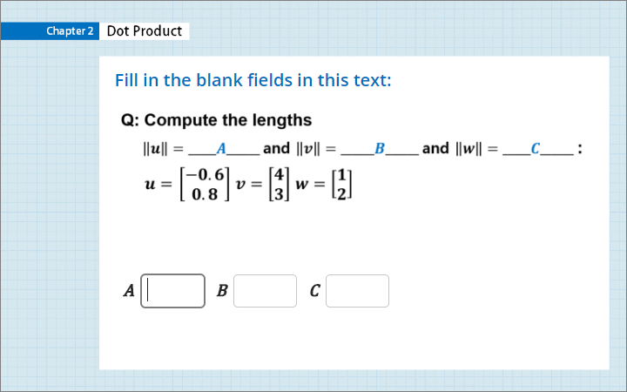
Quiz
Click the Quiz button to edit this object

Slide 13
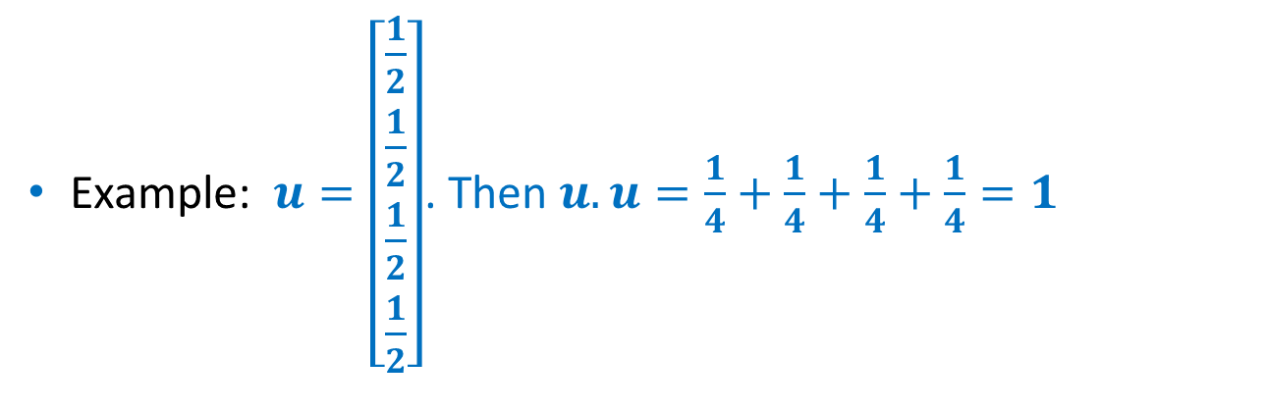

Unit Vector
A unit vector $u$ is a vector whose length equals one. Then $u.u=1$
Example: $u=\left[\begin{matrix}\frac{1}{2} \\ \begin{aligned}\frac{1}{2} \\ \frac{1}{2} \\ \frac{1}{2}\end{aligned}\end{matrix}\right]$. Then $u.u=\frac{1}{4}+\frac{1}{4}+\frac{1}{4}+\frac{1}{4}=1$

Slide 14


Unit Vector
Example: The standard unit vectors along the $x$ and $y$ axes are written $i$ and $j$.
In the $xy$ plane, the unit vector that makes an angle “$theta$” with the $x$ axis is $(cos θ,sin θ)$
Unit vectors $i=\left[\begin{matrix}1 \\ 0\end{matrix}\right]$ and $j=\left[\begin{matrix}0 \\ 1\end{matrix}\right]$ and $u=\left[\begin{matrix}cos θ \\ sin θ\end{matrix}\right]$

Slide 15
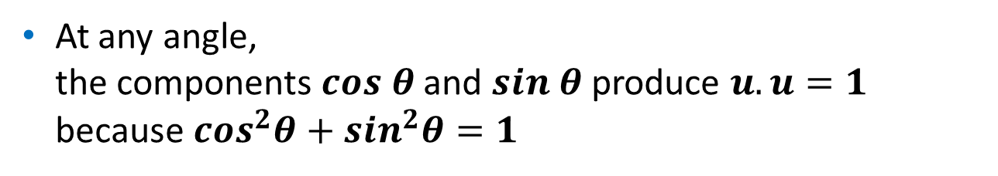
Unit Vector
When $θ=0$, the horizontal vector $u$ is $i$.
When $θ=90^{°}$, the vertical vector is $j$.
At any angle, the components $cos θ$ and $sin θ$ produce $u.u=1$ because $cos^{2}θ+sin^{2}θ=1$

Slide 16
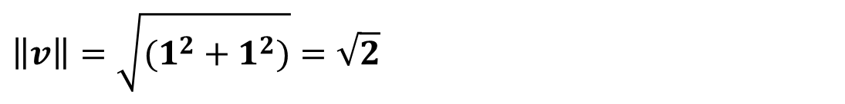
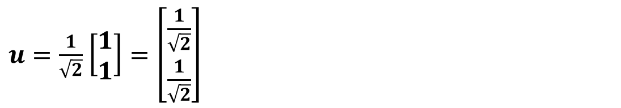
Unit Vector
For a unit vector, divide any non zero vector $v$ by its length $\left\|v\right\|$.
Unit vector: $u=\frac{v}{\left\|v\right\|}$ is a unit vector in the same direction as $v$.
Let $v=\left[\begin{matrix}1 \\ 1\end{matrix}\right].$ Then unit vector $u$ along the direction of $v$ is as follows.
$$\left\|v\right\|=\sqrt{(1^{2}+1^{2})}=\sqrt{2}$$
$u=\frac{1}{\sqrt{2}}$ $\left[\begin{matrix}1 \\ 1\end{matrix}\right]=\left[\begin{matrix}\frac{1}{\sqrt{2}} \\ \frac{1}{\sqrt{2}}\end{matrix}\right]$

Slide 17
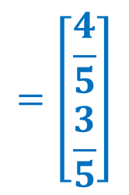
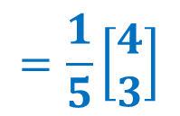
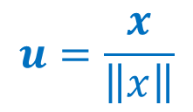
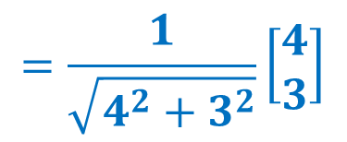
Unit Vector
What is the unit vector $u$ in the direction of $x=\left[\begin{aligned}4 \\ 3\end{aligned}\right]$
We divide by the length of $x$:
$$=\left[\begin{aligned}\frac{4}{5} \\ \frac{3}{5}\end{aligned}\right]$$
$$u=\frac{x}{\left\|x\right\|}$$
$$=\frac{1}{\sqrt{4^{2}+3^{2}}}\left[\begin{aligned}4 \\ 3\end{aligned}\right]$$
$$=\frac{1}{5}\left[\begin{aligned}4 \\ 3\end{aligned}\right]$$

Slide 18
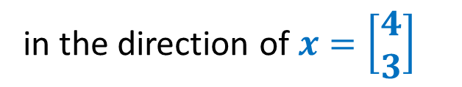



Unit Vector
What is the unit vector $u$
$$x$$
in the direction of $x=\left[\begin{aligned}4 \\ 3\end{aligned}\right]$
$$u$$

Slide 19
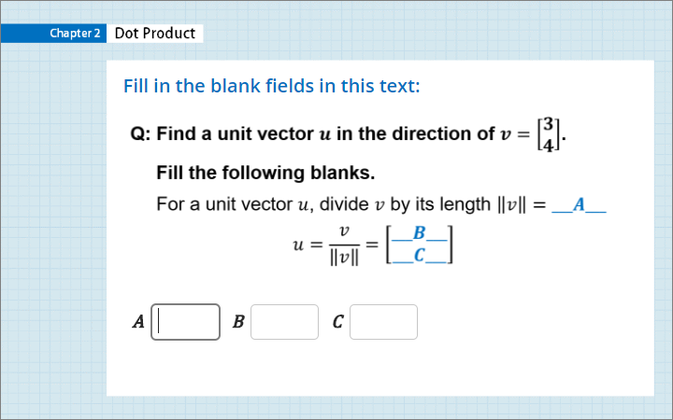
Quiz
Click the Quiz button to edit this object

Slide 20
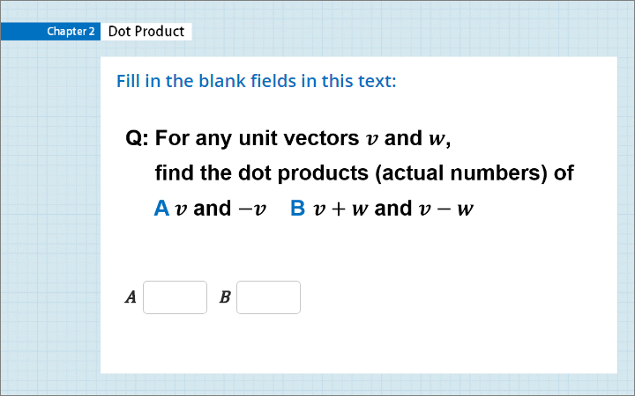
Quiz
Click the Quiz button to edit this object

Slide 21
Norm
A norm is a function from a real or complex vector space to the non-negative real numbers that behaves in certain ways like the distance from the origin.

Slide 22
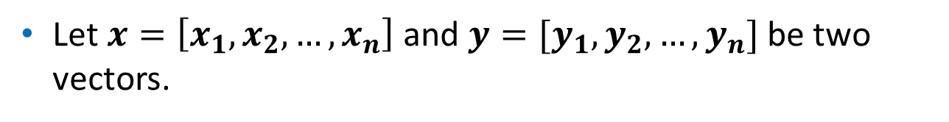
Norm
Let $x=\left[x_{1},x_{2},…,x_{n}\right]$ and $y=[y_{1}, y_{2},…,y_{n}]$ be two vectors.
Mathematically, a norm is a function $f$ that satisfies the
If $f\left(x\right)=0$ then $x=0$
$f\left(x+y\right)≤f\left(x\right)+f(y)$ → Triangle Inequality
For any scalar $α, f\left(αx\right)=|α|f(x)$ → Linearity

Slide 23

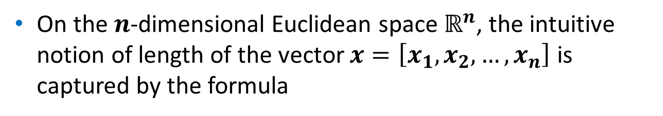
Euclidean Norm
On the $n$-dimensional Euclidean space $ℝ^{n}$, the intuitive notion of length of the vector $x=\left[x_{1},x_{2},…,x_{n}\right]$ is captured by the formula
$${\left\|x\right\|}_{2}=\sqrt{x_{1}^{2}+x_{2}^{2}+…+x_{n}^{2}}$$
This is the Euclidean norm
This operation may also be referred to as "SRSS", which is an acronym for the square root of the sum of squares.

Slide 24

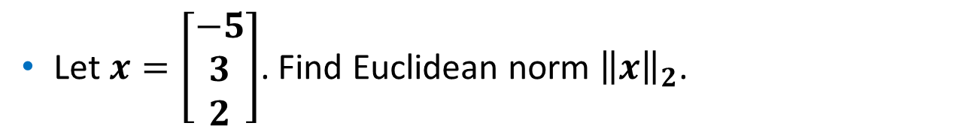
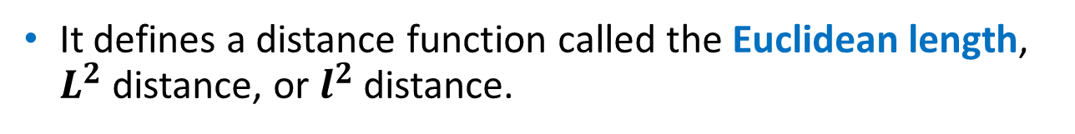



Euclidean Norm
The Euclidean norm is also called the $L^{2}$ norm, $l^{2}$norm, or square norm.
It defines a distance function called the Euclidean length, $L^{2}$ distance, or $l^{2}$ distance.
Let $x=\left[\begin{aligned}−5 \\ 3 \\ 2\end{aligned}\right]$. Find Euclidean norm ${\left\|x\right\|}_{2}$.
$${\left\|x\right\|}_{2}=\sqrt{−5^{2}+3^{2}+2^{2}}$$
$$=\sqrt{25+9+4}$$
$$=\sqrt{38}$$

Slide 25
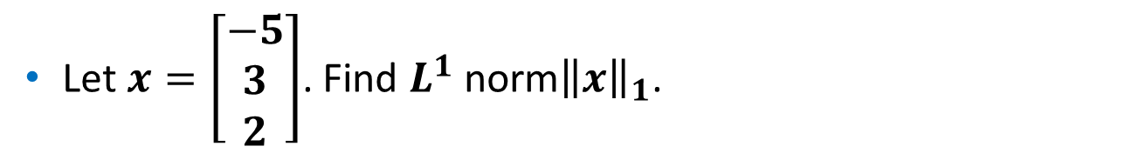


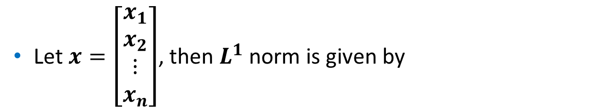



$L^{1}$ Norm
Let $x=\left[\begin{aligned}x_{1} \\ x_{2} \\ ⋮ \\ x_{n}\end{aligned}\right]$, then $L^{1}$ norm is given by
$${\left\|x\right\|}_{1}=\left|x_{1}\right|+\left|x_{2}\right|+…+|x_{n}|$$
Let $x=\left[\begin{aligned}−5 \\ 3 \\ 2\end{aligned}\right]$. Find $L^{1}$ norm${\left\|x\right\|}_{1}$.
$${\left\|x\right\|}_{1}=\left|−5\right|+\left|3\right|+|2|$$
$${\left\|x\right\|}_{1}=5+3+2$$
$${\left\|x\right\|}_{1}=10$$

Slide 26

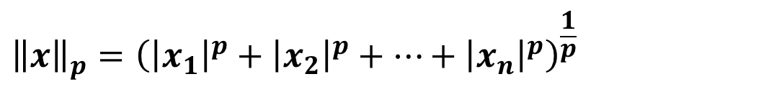


$p$-Norm
Let $x=\left[\begin{aligned}x_{1} \\ x_{2} \\ ⋮ \\ x_{n}\end{aligned}\right]$ and $p≥1$be a real number.
The $p$-norm (also called $l_{p}$-norm) is given by
$${\left\|x\right\|}_{p}={\left({\left|x_{1}\right|}^{p}+{\left|x_{2}\right|}^{p}+…+{\left|x_{n}\right|}^{p}\right)}^{\frac{1}{p}}$$

Slide 27

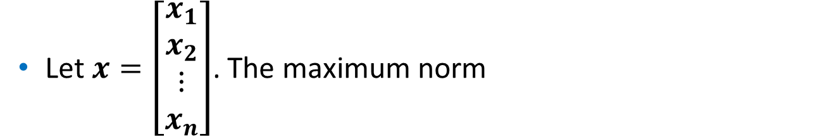
Maximum Norm or Infinity Norm
Let $x=\left[\begin{aligned}x_{1} \\ x_{2} \\ ⋮ \\ x_{n}\end{aligned}\right]$. The maximum norm
(also called Infinity norm) is given by
$${\left\|x\right\|}_{∞}=max(\left|x_{1}\right|,\left|x_{2}\right|,…,\left|x_{n}\right|)$$
Let $x=\left[\begin{aligned}−5 \\ 3 \\ 2\end{aligned}\right]$. Find maximum norm ${\left\|x\right\|}_{∞}$
$${\left\|x\right\|}_{∞}=max\left(\left|−5\right|,\left|3\right|,\left|2\right|\right)$$
$${\left\|x\right\|}_{∞}=max\left(5, 3, 2\right)$$
$${\left\|x\right\|}_{∞}=5$$

Slide 28
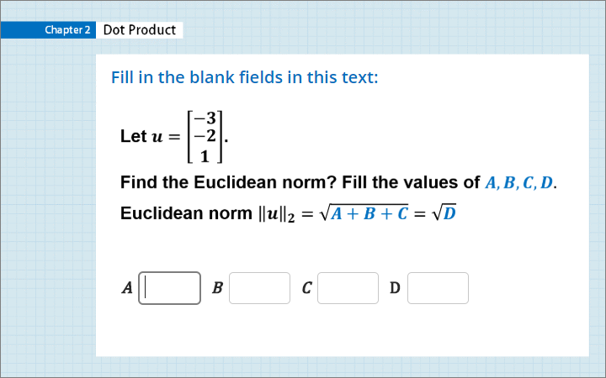
Quiz
Click the Quiz button to edit this object

Slide 29
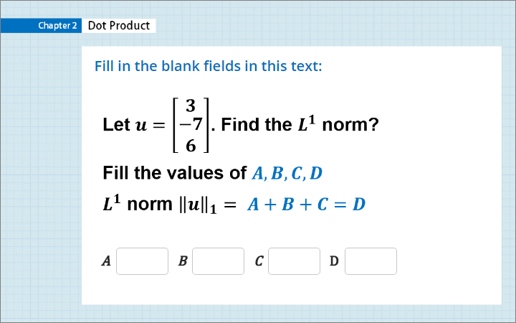
Quiz
Click the Quiz button to edit this object

Slide 30
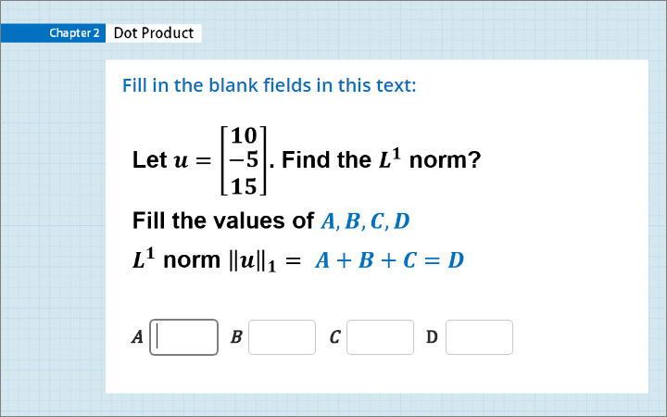
Quiz
Click the Quiz button to edit this object

Slide 31
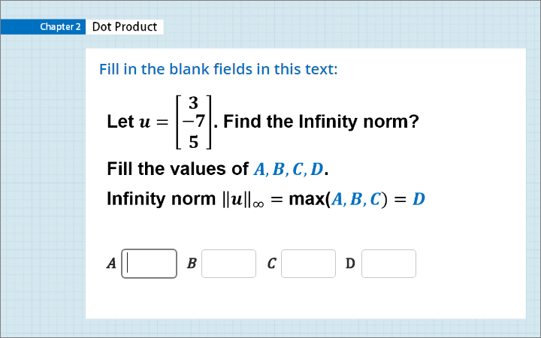
Quiz
Click the Quiz button to edit this object

Slide 32
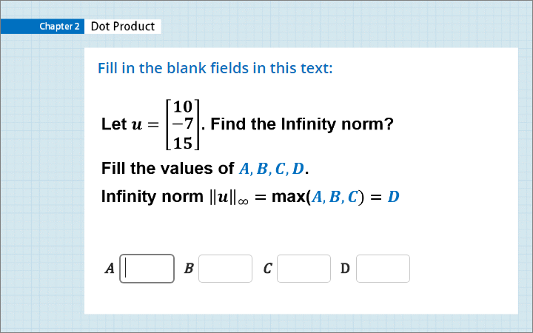
Quiz
Click the Quiz button to edit this object

Slide 33
Summary
Dot Product
Length of a vector
Unit vector
Norm

